Slide 1
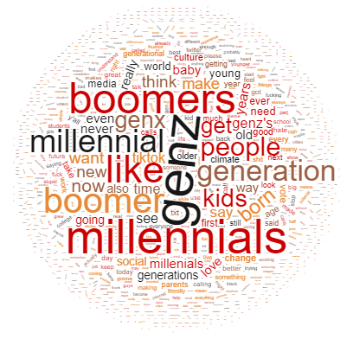
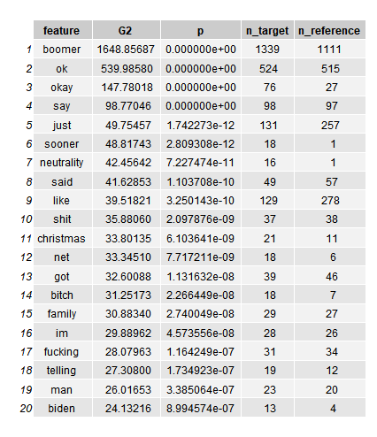
Climate Change, Memes, & the Workplace: A Comparison of Generational Correlates on Online Platforms
Elyse Endlich
Introduction
The viral phrase ‘Ok boomer’ piqued my interest– I wanted to see if the internet had any other collocations for generations.
Hypotheses:
‘Ok boomer’ = high incidence rate
Boomers correlated with centrist/conservative views
Millennials = laziness
Gen Z = possibly climate change
Data
Built new corpus
Used Octoparse to scrape data
Search terms: “gen z,” “millennial,” “boomer”
Websites: Twitter, Google, Google Scholar
7 categories: boomer / Gen Z / millennial tweets, boomer / Gen Z / millennial Google searches, all three terms on Google Scholar
Original data set (DS) before cleaning:
Twitter – ~8,000 tweets
Google – ~640 Google Searches
Google Scholar - ~750 articles
How do people talk about Gen Z, boomers, & millennials online?
Results
DSs varied not only by generation, but also by platform.
Google is used by older folks whereas Twitter used by predominantly young people.
Google searches focused on reaction of older people to ‘ok boomer’ (phrase, meme, viral, internet, weapon) & employing/marketing to Gen Z (digital, marketing, brands, work[force|place], employers).
Twitter boomer set was negative (fucking, shit, bitch); Twitter Gen Z set focused on topics & issues that interest Gen Z, reflected Gen Z language (climate change, Tik Tok, vote, planet; bc, y’all, txt, like).
Google Scholar focused on the health concerns of boomers (boomer women, boomer retirement, cohort, health, nurses, aging).
Findings surrounding millennial were not as conclusive.
Method
Removed duplicates, manually cleaned data in Excel (removed instances of “boomer” as name or football team, removed one outlier Twitter account)
Condensed DS to tweet content (Twitter) & article title & description (Google & Google Scholar)
Loaded data into R Studio
Stripped dates, URLs, & all punctuation except ‘, removed spaces from certain phrases (“gen z” → “genz”) to see collocations of phrase better & treat as one unit
Created bigrams & trigrams
Calculated mutual information & T score for bigrams, sorted by score & controlled for occurrence rates
Created corpus of all data, then calculated keywords for each DS
Word cloud generated from tweets containing “gen z”
Top 20 keywords from tweets containing “boomer”
Discussion
Found backing for hypotheses
Ok boomer = high prevalence rate across almost every DS
Biden, family, Christmas were keywords of Twitter boomer DS
Procrastination was a keyword of Google millennial DS
Climate change featured prominently in Twitter gen z DS
Negative tone of Twitter boomer DS = attitudes of young people towards boomers?
Conclusion
Generation terms & platform under study both have an influence on the important words of each DS as determined by mutual information, T scores, & keyness analyses.
Future studies analyzing online data must take these factors into account.
Gen Z uses Twitter to criticize boomers & discuss climate change & other interests.
Generations older than Gen Z are interested in marketing to & employing them, also feel attacked by ok boomer.
Future research: examine other online platforms, do diachronic analysis instead of synchronic, retry data collection & analysis of millennial.

